Slide 1


Slide 2


Slide 3

Agenda
Problem Statement
Introduction
Why anime ?
Scrapping data from web site
Before Data set Cleaned
After Data Set Cleaned
Data Set Overview
Genre Analysis
Production Influences
Viewer Engagement Matrices
Quality Indicators
Narration Preferences
Key insights
Conclusion
Next –steps
Thank Givings.

Slide 4

Problem statement :
Embark on a data-driven journey through the realm of anime creation. Leverage insights from a comprehensive dataset encompassing key attributes of successful anime series. Uncover trends, preferences, and success factors to inform strategic decisions and maximize the commercial potential of future anime ventures.

Slide 5

Introduction
Welcome to the Presentation on developing an successful anime series using the data-driven approach, As an inspiring anime creators , our future goal is to captivate audiences and achieve commercial success. Today we'll explore analyzing key attributes from existing anime series can guide us in creating our new anime compelling series.

Slide 6

Why anime ?
Anime is a unique genre of animation that can be entertaining, emotionally powerful, and visually stunning.
Provide a break from reality : Anime can help viewers temporarily immerse themselves in captivating stories.
Spark joy : Anime can help alleviate stress and uplift spirits by serving as an entertaining medium that sparks joy, laughter, and excitement.
Tell stories in a unique way : Anime can tell stories in a way that traditional Western media cannot.
Embrace diverse themes : Anime can embrace diverse themes, from existential philosophy.
Provide social commentary : Anime storylines can provide social commentary on past, present, and future landscape, even touching on political notes that resonate with viewers around the globe.
Provide a realistic portrayal of culture : Anime has had a significant impact on the way that people view culture.
Provide an avenue for people to express their creativity : Anime can provide an avenue for people to express their creativity and explore their passions.

Slide 7
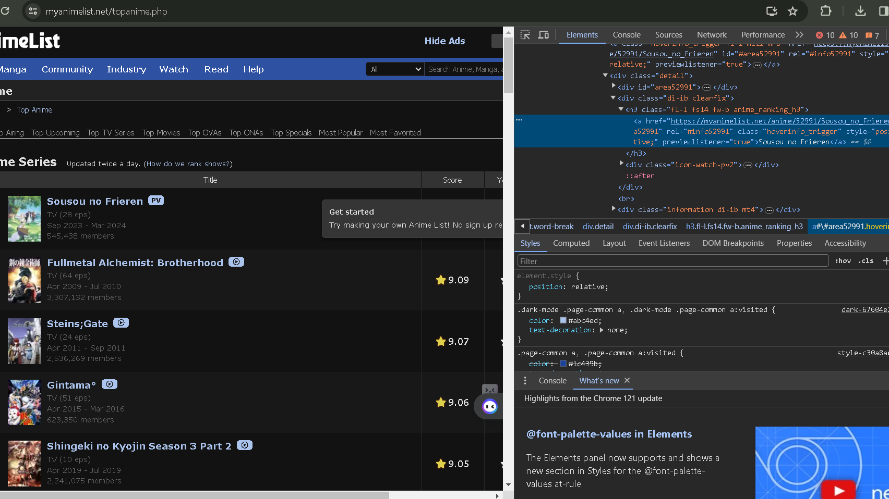
Scrapping from web site

Slide 8
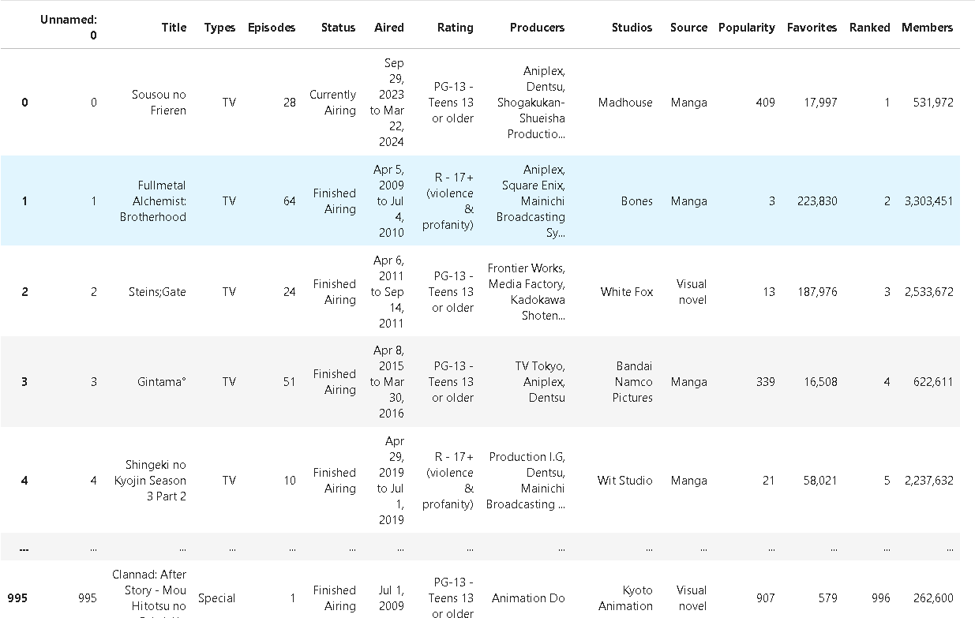
Before cleaning the data

Slide 9
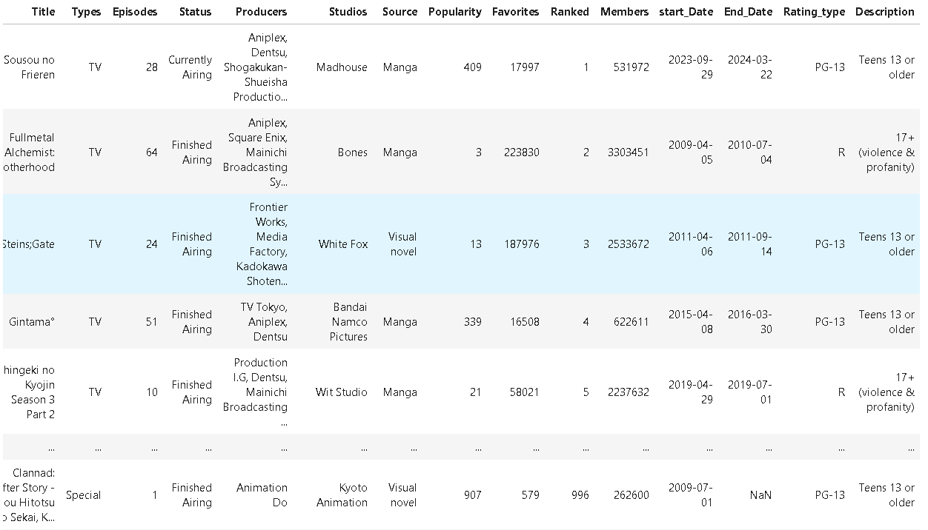
After data set cleaned

Slide 10

Data Set Overview
Introduction to the dataset attributes and their importance for analysis

Slide 11

Data set overview
Title - Anime name
Types - TV, Movie, OVA, Special, ONA
Episodes - Depends upon anime story
Status - Currently Airing, Finished Airing
Producers - Manage the director and all the other departments to ensure a project's delivered on time, within budget and to the best creative brief.
Studios - Where they start shooting the series of anime
Source - Manga, Visual novel, Novel, Original, Light novel, 4-koma manga, Web manga, Web novel, Game, Other, Mixed media, Book, Unknown, Music, Picture book
Popularity - Anime has grown extremely popular
Flavorites - Anime they liked
Ranked - Anime can be ranked as masterpieces, excellent, or very good.
Members - Viewers who watched that particular anime
Start_Date - Start date of anime
End_Date - Ending date of anime
Rating_type - PG-13, R, R+, PG, G
Description - Teens 13 or older, 17+ (violence & profanity), Mild Nudity, Children, All Ages

Slide 12

Genre analysis
Analyzing popular genres and their impact on series success

Slide 13
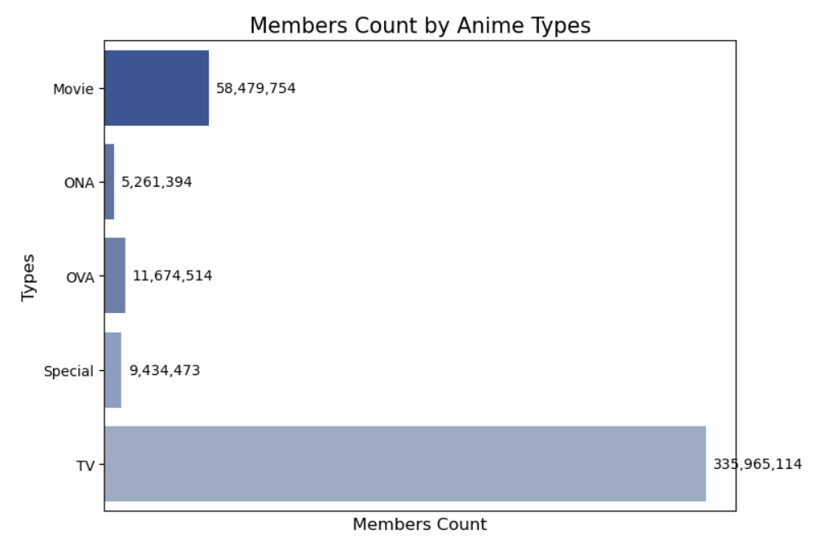
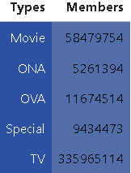
Genre analysis

Slide 14


Production influencing
Exploring the influence producers and studios on anime series

Slide 15
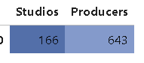
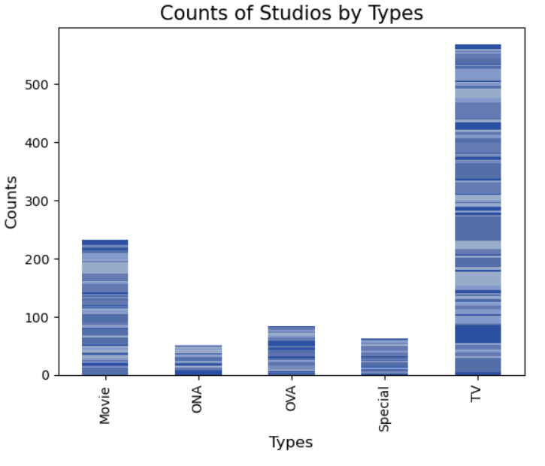
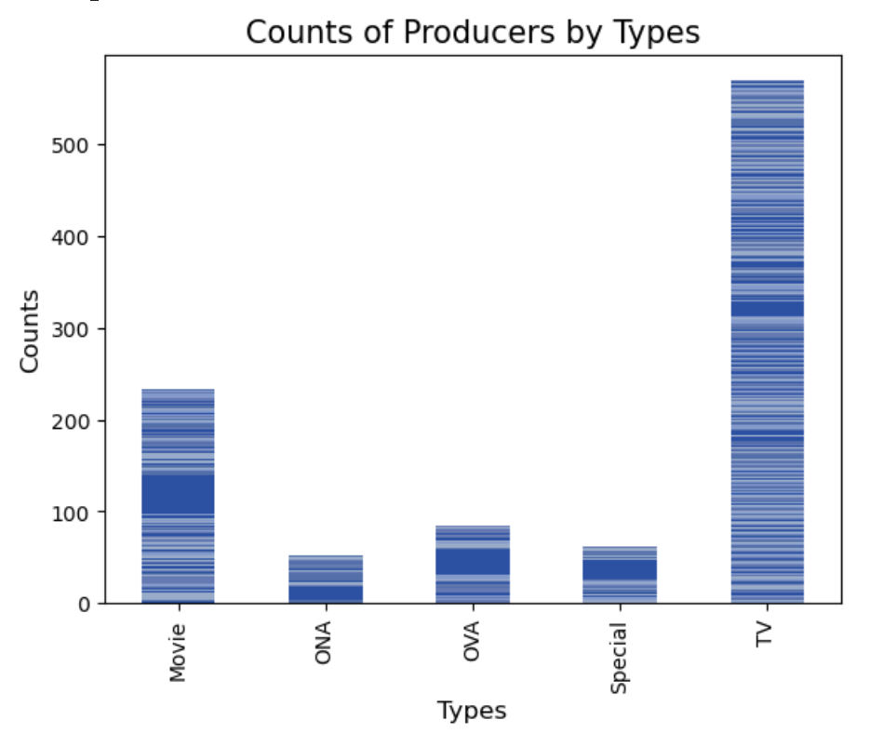

Slide 16

VIEWER ENGAGEMENT MeTRICES
Understanding viewer engagement through metrices like popularity and favourites

Slide 17
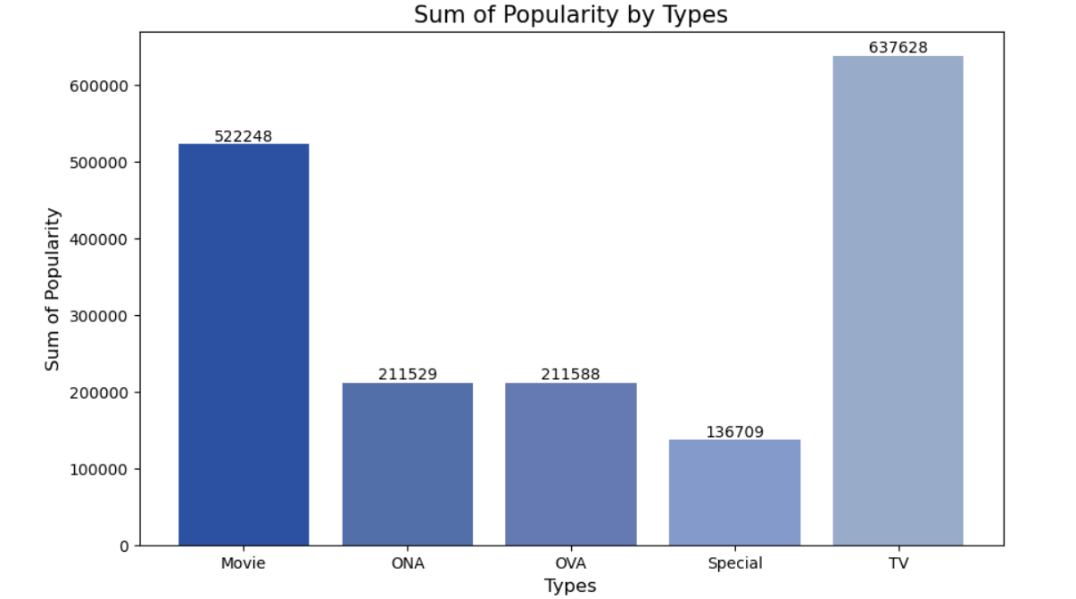
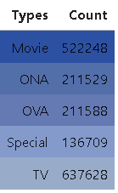
POPULARITY ANALYSIS

Slide 18
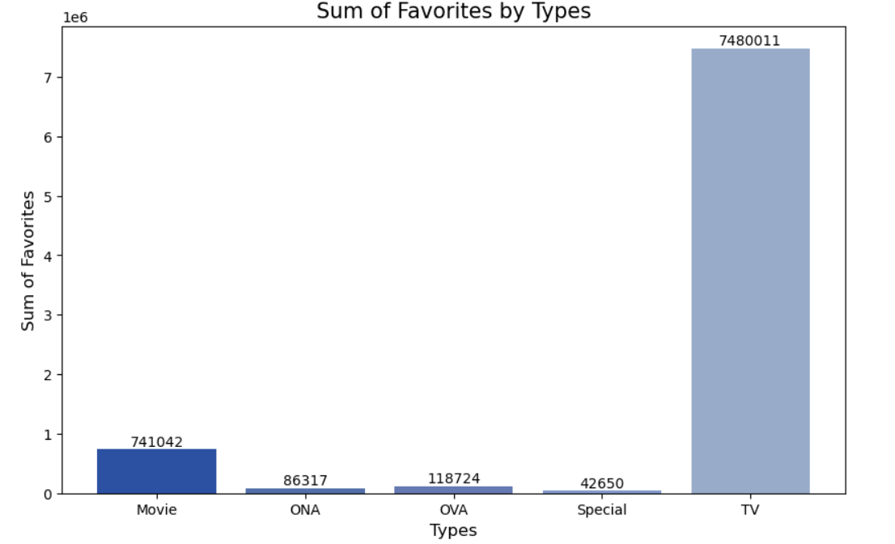
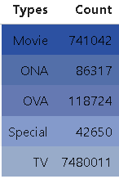
FAVORITES ANALYSIS

Slide 19

Quality indicators
Examine indicators of quality such as ranking and rating

Slide 20
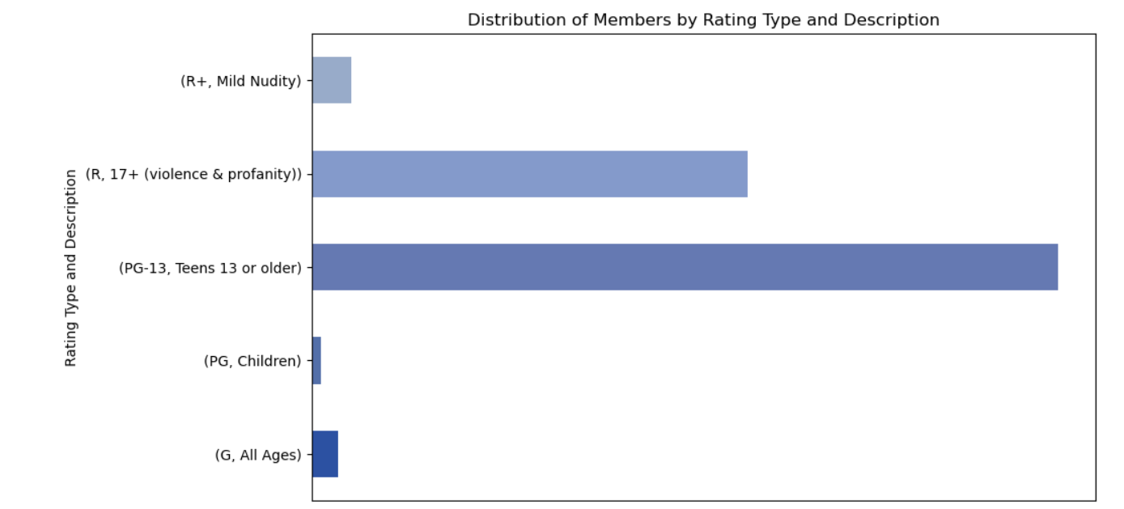
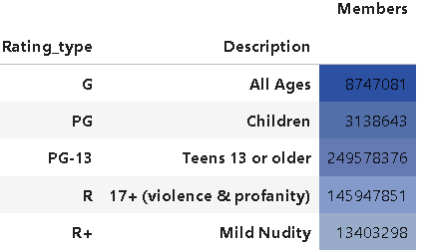
RATING_TYPE ANALYSIS

Slide 21

Narrative preferences
Analysing narrative preferences and storytelling techniques

Slide 22
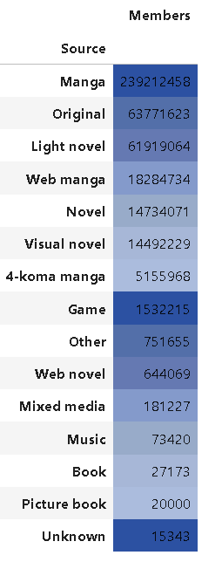
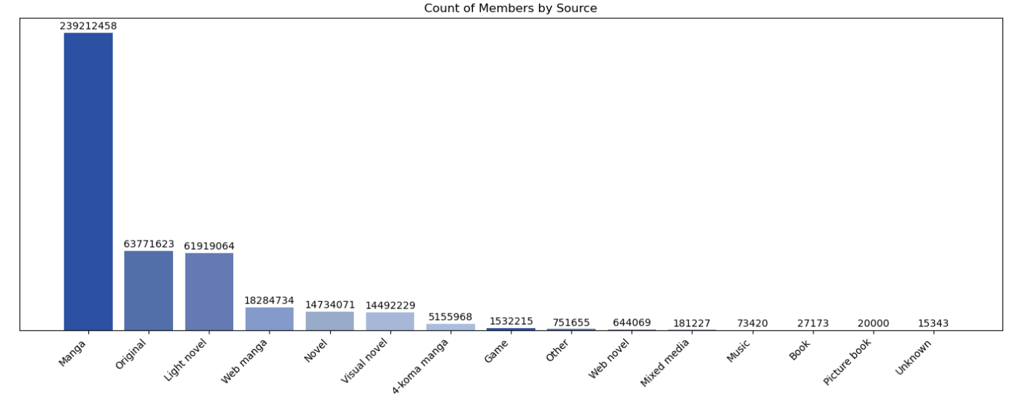
Story analysis

Slide 23

Key insights
Analysing key – insights which helpful for further future

Slide 24

Key – insights :
Types of Anime: Understanding the distribution of anime series across different types such as TV, Movie, OVA, Special, and ONA can provide insights into the variety of content available.
Number of Episodes: Analyzing the distribution of episodes can reveal trends in episode length and potentially correlate with popularity or audience engagement.
Status of Series: Examining the status of anime series (e.g., Currently Airing, Finished Airing) can help understand the lifecycle of series and their popularity over time.
Source Material: Understanding the source material for anime series (e.g., Manga, Novel, Game) can provide insights into adaptation trends and the popularity of different source materials.
Popularity and Ranking: Exploring popularity rankings and ratings can help identify highly regarded anime series and understand audience preferences.
Production and Studios: Analyzing producers and studios involved in creating anime series can provide insights into industry trends and the influence of production companies on series success.

Slide 25

Key - insights
Member Engagement : Examining the number of members who have added anime series to their can indicate audience interest and engagement with specific series.
Start and End Dates : Analyzing start and end dates of anime series can reveal seasonal trends and the duration of series popularity.
Rating Type : Understanding the rating types (e.g., PG-13, R, R+) can provide insights into the target audience and content suitability.
Description: Reviewing descriptions or summaries of anime series can help understand the themes, genres, and plotlines of different series.

Slide 26

Future scope
Personalized Recommendations:
Enhancing recommendation systems with user behaviour data and advanced algorithms can significantly improve user engagement and satisfaction by delivering personalized content recommendations tailored to individual preferences.
Advanced Predictive Modelling:
Exploring deep learning and ensemble methods for predictive modelling can lead to more accurate forecasts of audience preferences, popularity trends, and other key metrics, enabling better decision-making and strategic planning in the anime industry.
Market Segmentation:
Refining audience segmentation based on demographic factors, viewing habits, and psychographic characteristics allows for targeted marketing strategies, maximizing the effectiveness of promotional efforts and content distribution.

Slide 27

CONCLUSION
In summary, our analysis of the anime dataset provided valuable insights into audience preferences and market trends. Key findings include the importance of personalized recommendations and advanced predictive modelling in optimizing user experience and driving business success in the anime industry.

Slide 28

Thank you

